Slide 1
Main Memory Management
Hamid R. Zarandi
h_zarandi@aut.ac.ir

Slide 2
Why memory management?
CPU utilization and increase of performance
→ need of scheduler to schedule multiple processes
→ they should be resident in RAM (physical memory)
Why need of memory management?
Having multiple processes
Protection (processes from one another, processes from OS)
Protection should be done by Hardware than OS (why?)
Performance penalty and latency

Slide 3
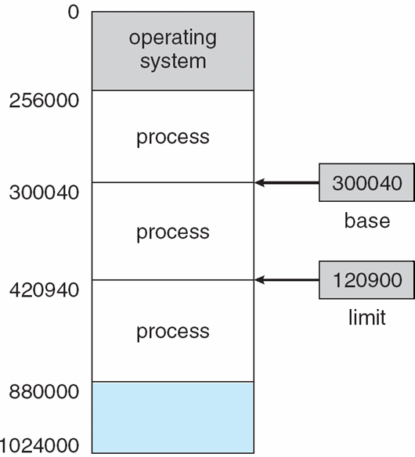
How to protect process memory space?
Each process has a separate memory space
To protect processes’ spaces
Determining legal address
Base register (پایه): smallest legal physical memory address
Limit register (حد): size of the range
Example:
Base register = 300040
Limit register = 120900
Legal address space:
Base <= (any address) < Base+Limit
Can easily be checked by hardware

Slide 4
HW address protection (base & limit regs.)
Any illegal address generates a trap exception which is known as fatal error
Who loads Base and Limit registers?

Slide 5
Address binding

Slide 6
Address binding
Input Queue
Processes on disk that are waiting to be brought into memory during execution (Part of ready queue which is on disk)
How to put a process in a physical address?
Addresses in source program are symbolic
Example: count variable
A compiler binds them to relocatable addresses
Example: 14 bytes from beginning of this module
Linker and loader bind them next to absolute addresses
Example: 74014

Slide 7
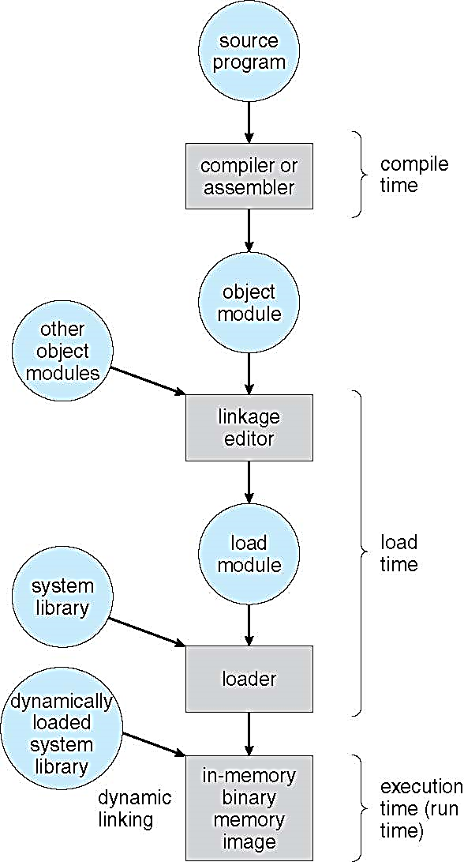
How to bind inst./data to mem. address?
Compile time
If memory location known a priori, absolute code can be generated; must recompile code if starting location changes
Example: COM files in MS-DOS
Load time
Must generate relocatable code if memory location is not known at compile time
Execution time
Binding delayed until run time if the process can be moved during its execution from one memory segment to another
Need hardware support for address maps
Example: Base-Limit registers

Slide 8
Logical vs. physical address space
Logical address (CPU address)
CPU logically sees addresses
Logical address space: set of all logical addresses generated by a program
Physical address (Memory address)
Address of memory line
Physical address space: set of all physical addresses generated by a program
May be equal or not
Equal: compile-time and load-time address bindings
Not equal: execution-time address binding
In this case, logical address is said virtual address

Slide 9
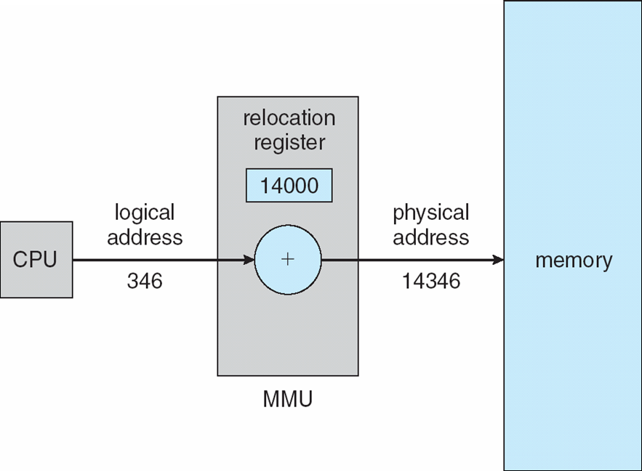
What is MMU (Memory Management Unit)?
MMU is responsible of mapping virtual (logical) address to physical address
Simple version: Base-Limit registers
Here Base register is called relocation register

Slide 10
Dynamic linking and loading

Slide 11
Dynamic loading
Dynamic loading
A routine is not loaded until it is called
All routines except main() are kept on disk
Better space utilization
Some routines are infrequently needed: error functions
In the case of call, if it is not loaded, linking loader first loads it to the memory and update program’s address table to reflect this change

Slide 12
Dynamic linking
Dynamic linking (Dynamically linked libraries)
System libraries that are linked to user programs when they are run
No waste of memory and disk space
Example: Language subroutines
Stub: small piece of code used to locate dynamic linked libraries
Replace itself with the address of the routine & executes the routine
Also known as Shared Libraries
Static linking
System libraries are linked to user programs during compile time

Slide 13
Swapping

Slide 14
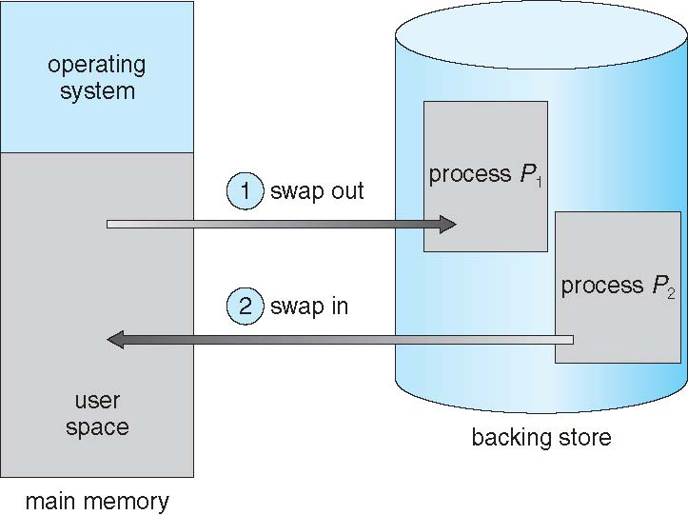
Swapping
Swapping is performed temporarily between memory and backing store
Backing store – fast disk large enough to accommodate copies of all memory images for all users; must provide direct access to these memory images
Possible of total process memory spaces exceeds real physical memory
→ Use of Backing store

Slide 15
Swapping issues
Does the swapped out process need to swap back in to same physical addresses?
Depends on address binding method
Plus consider pending I/O to/from process memory space
Pending IO: cannot swap out as IO would occur to wrong swapped in process!
Or always transfer IO to kernel space, then to IO device; this is known as double buffering; adds overheads

Slide 16
Swapping and modern OSs
Standard swapping is not used in Linux & Windows!
Modified version is used:
Swap only when free memory is extremely low (less than threshold)
Disable swapping when free memory is more than threshold

Slide 17
Swapping cost
Major part of swap time is transfer time
Total transfer time is proportional to the amount of memory swapped.
Example:
100 MB process swapping to hard disk with transfer rate of 50 MB/sec
Swap out time of 2(sec)+swap in of same size process
Total context switch swapping component time of 4 sec.

Slide 18
Memory allocation

Slide 19
Memory allocation
Different types
Contiguous
Each process is in a single section of memory that is contiguous to sections of others
Segmentation
Each process is divided into different segments; each one is located in different part
Paging
Each process is divided into same–small–size pages; some of them are swapped in/out

Slide 20
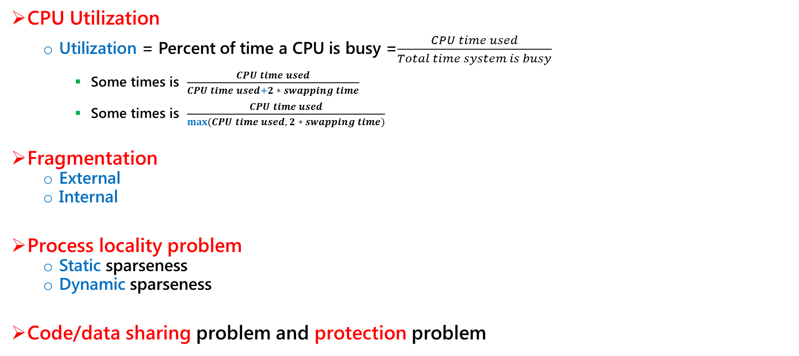
Criteria and problems
CPU Utilization
Utilization = Percent of time a CPU is busy =$\frac{CPU time used}{Total time system is busy}$
Some times is $\frac{CPU time used}{CPU time used+2 ∗ swapping time}$
Some times is $\frac{CPU time used}{max⁡(CPU time used, 2 ∗ swapping time)}$
Fragmentation
External
Internal
Process locality problem
Static sparseness
Dynamic sparseness
Code/data sharing problem and protection problem

Slide 21
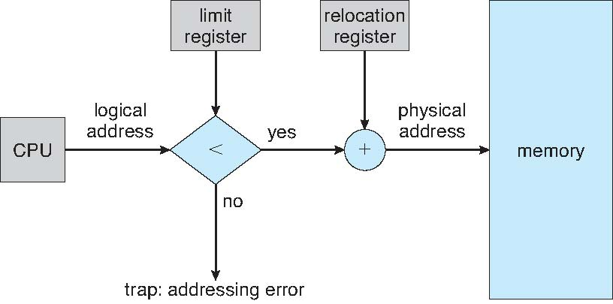
1) Contiguous allocation
Relocation registers used to protect user processes from each other, and from changing operating-system code and data
Base register contains value of smallest physical address
Limit register contains range of logical addresses
Each logical address must be less than the limit register

Slide 22
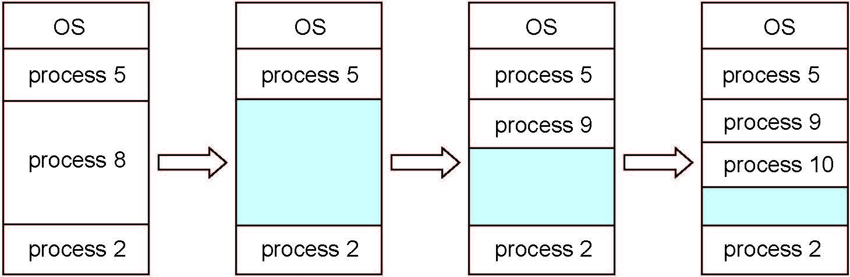
Multiple-partition memory allocation
Degree of multiprogramming limited by number of partitions
Variable-partition sizes for efficiency (sized to a given process’ needs)
Hole – block of available memory; holes of various size are scattered throughout memory
When a process arrives, it is allocated memory from a hole large enough to accommodate it
Operating system maintains information about: a) allocated partitions b) free partitions (hole)

Slide 23
Dynamic storage-allocation problem
How to satisfy a request of size n from a list of free holes?
First-fit: Allocate the first hole that is big enough
Best-fit: Allocate the smallest hole that is big enough; must search entire list, unless ordered by size
Produces the smallest leftover hole
Worst-fit: Allocate the largest hole; must also search entire list
Produces the largest leftover hole
First-fit and best-fit better than worst-fit in terms of speed and storage utilization

Slide 24
Fragmentation problem
External Fragmentation
Total memory space exists to satisfy a request, but it is not contiguous
Internal Fragmentation
Not whole of allocated memory is filled by the process memory
First fit analysis reveals that given N blocks allocated, 0.5 N blocks lost to fragmentation
1/3 may be unusable -> 50-percent rule

Slide 25
Fragmentation solution
Compaction
Shuffle memory contents to place all free memory together in one large block
Compaction is possible only if relocation is dynamic, and is done at execution time
I/O problem
Latch job in memory while it is involved in I/O
Do I/O only into OS buffers
Now consider that backing store has same fragmentation problems

Slide 26
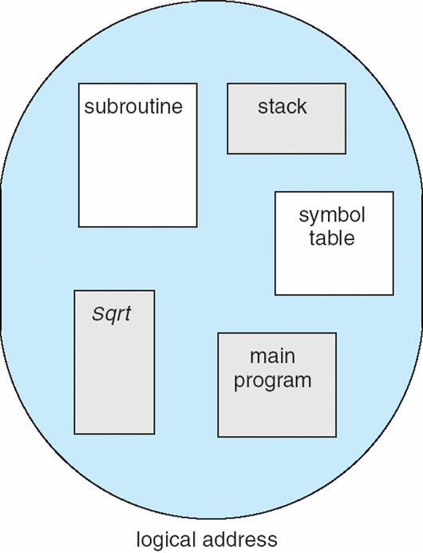
2) Segmentation
Memory-management scheme that supports user view of memory
A program is a collection of segments
A segment is a logical unit such as:
main program
procedure
function
method
object
local variables, global variables
common block
stack
symbol table
arrays

Slide 27
logical view of segmentation
1
1
4
2
3
4
2
3
user space
physical memory space

Slide 28
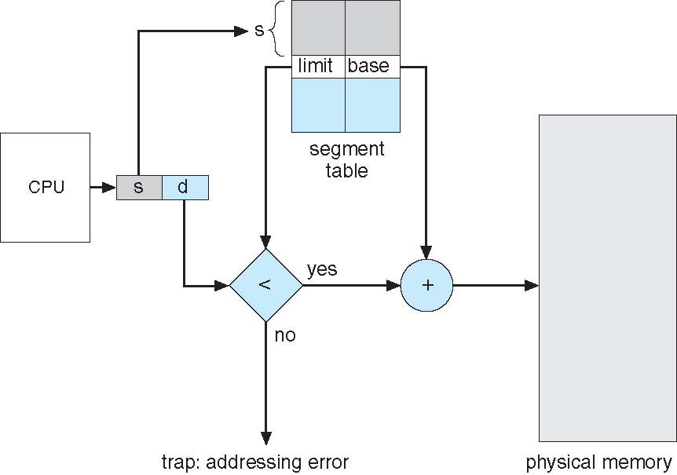
Segmentation implementation
Logical address consists of a two tuple: <segment-number, offset>
Segment table
Maps two-dimensional physical addresses; each table entry has:
base – contains the starting physical address where the segments reside in memory
limit – specifies the length of the segment

Slide 29
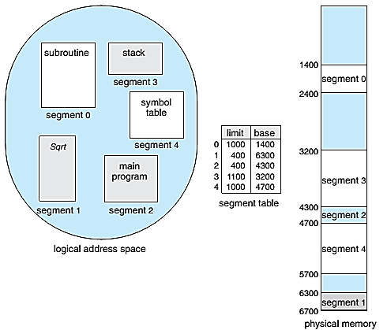
Example of segmentation
A reference to byte 53 of segment 2:
4300+53=4353
A reference to byte 852 of segment 3:
3200+852=4052
A reference to byte 1222 of segment 0:
Trap to OS!

Slide 30
3) Paging
Noncontiguous memory allocations:
Segmentation
Paging
Paging avoids external fragmentation, and need of compaction, whereas segmentation does not.
Process is allocated physical memory whenever physical memory is available
Avoid external fragmentation
Avoid problem of varying sized memory chunks
Divide physical memory into fixed-sized blocks called frames.
Size is power of 2, between 512 bytes to 16 Mbytes
Divide logical memory into blocks of same size called pages.

Slide 31
Paging
Keep tracks of all free frames
To run a program with N pages, need to find N different free frames and load program.
Setup a page table to translate logical to physical address
Still have internal fragmentation

Slide 32
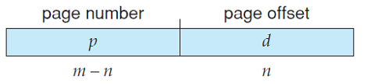
Address translation scheme
CPU address (Logical address) is divided into two parts:
Page number (p): used as an index into a page table that contains base register of each page in physical memory
Page offset (d): combined with base address to define the physical memory address that is sent to the memory unit.
For given logical address space 2^{m} and page size 2^{n}

Slide 33
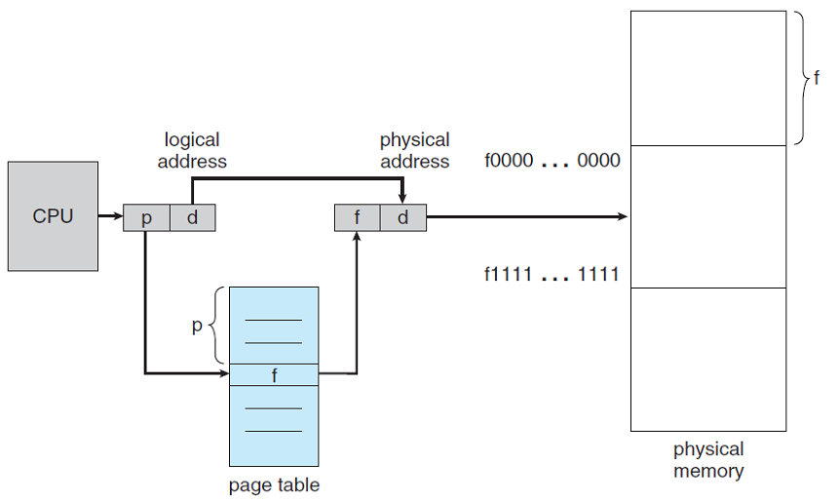
Paging hardware

Slide 34
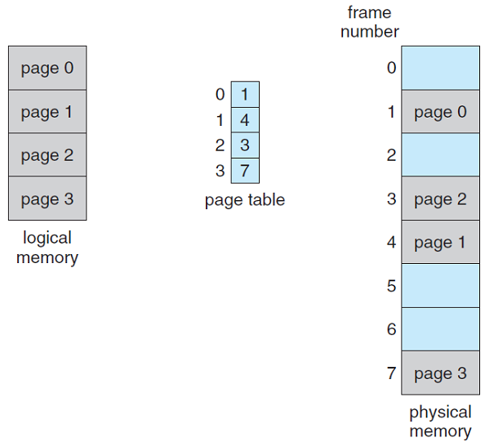
Paging model of logical and physical memory

Slide 35
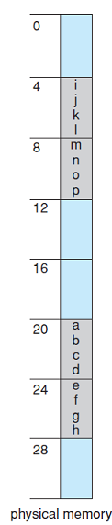
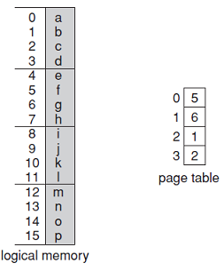
Paging example
n=2 and m=4, 32-byte memory and 4-byte pages.

Slide 36
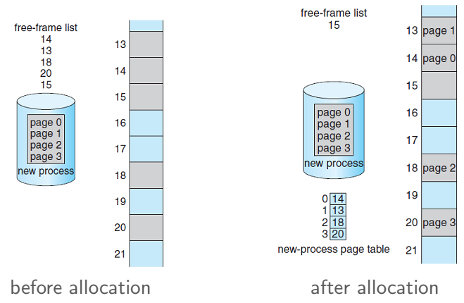
Free frames

Slide 37
Paging example – Internal fragmentation
Page size = 2048 bytes (2kB)
Process size = 72766 bytes
72766/2048 = 35 pages +1086 bytes
Internal fragmentation: 2048 – 1086 = 962 bytes
Worst case fragmentation: 1 frame – 1 byte
On average fragmentation: ½ frame size

Slide 38
Small page size vs big page size
On average fragmentation: ½ page size, small page size are good.
Small page size, more overhead is in the page-table, this overhead is reduced when page size increases.
Disk I/O is more efficient when the amount of data being transferred is larger (e.g. big pages)
Page typically are between 4 kB and 8 kB in size.

Slide 39
Page table implementation

Slide 40
Page table
Page table is kept in memory
Page-table base register (PTBR) points to the page table
Page-table length register (PTLR) indicates size of the page table
In this scheme every data/instruction access requires two memory accesses:
One for the page table, another for data/instruction

Slide 41
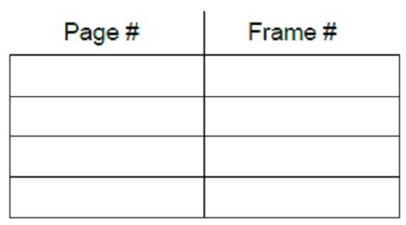
Translation look-aside buffer (TLB)
The two memory access problem can be solved by the use of a special fast-lookup hardware cache called associative memory or translation look-aside buffer (TLB).
Associative memory: parallel search
Address translation (p, d):
If p is in associative memory, get frame# out
Otherwise, get frame# from page table in memory

Slide 42
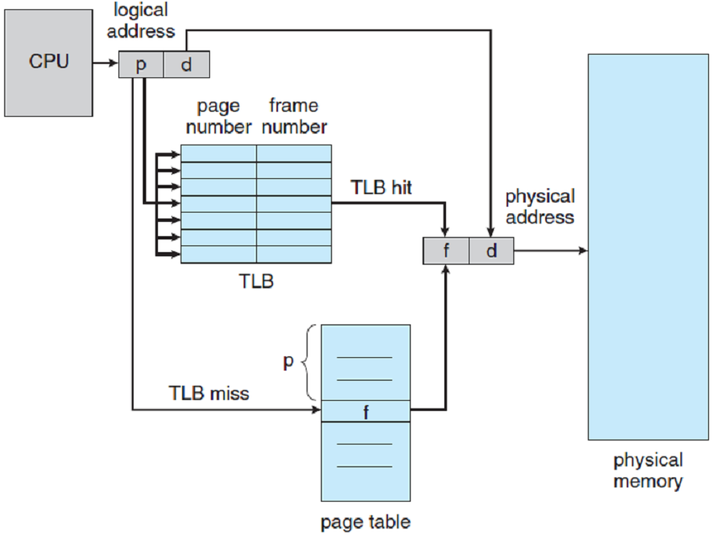
Paging hardware with TLB

Slide 43
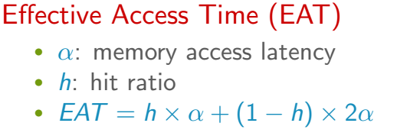
Effective access time
Hit ratio: percentage of times that a page number is found in the TLB.

Slide 44
More about TLB
Some TLBs store address-space identifier (ASID) in each TLB entry
Uniquely identifies each process to provide address-space protection for that process
Otherwise, need to flush at every context switch
TLB is typically small (64 to 1024 entries)
On a TLB miss, value is loaded into the TLB for faster access next time.
Replacement policies must be considered.

Slide 45
Memory protection
Memory protection is implemented by protection bit with each frame to indicate if read-only or read-write access is allowed.
Valid-invalid bit attached to each entry in page table:
Valid indicates that the page is in the process logical address space (legal page)
Invalid indicates that the page is not in the process logical address space (illegal page)
Or use page-table length register (PTLR)
Any violation result in trap to the kernel

Slide 46
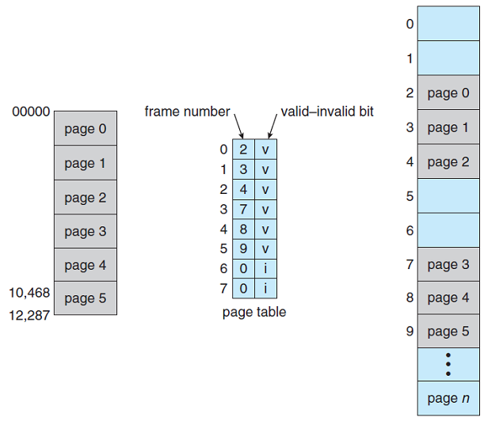
Valid/invalid bit in a page table

Slide 47
Shared pages
Shared code
One copy of read-only (reentrant) code shared among processes (e.g., text editors)
Similar to multiple threads sharing the same process space.
Private code and data
Each process keeps a separate copy of the code and data
The page for the private code and data can appear anywhere in the logical address space

Slide 48
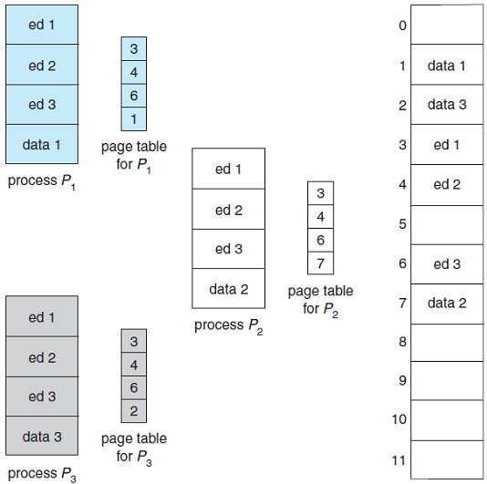
Shared pages - Example

Slide 49
Problem of big page tables
Memory structure for paging can get huge using straight-forward methods.
Consider a 32-bit logical address space on a modern computers:
Page size of 4 kB = 2¹²
Page table would have 1 million entries (2³² /2¹²)
If each entry is 4 B: 4 MB of physical address space memory for page table alone.
The amount of memory used, cost a lot
Don’t want to allocate that contiguously in the memory

Slide 50
Solutions to maintain huge page tables
A) Hierarchical paging
B) Hashed page tables
C) Inverted page tables

Slide 51
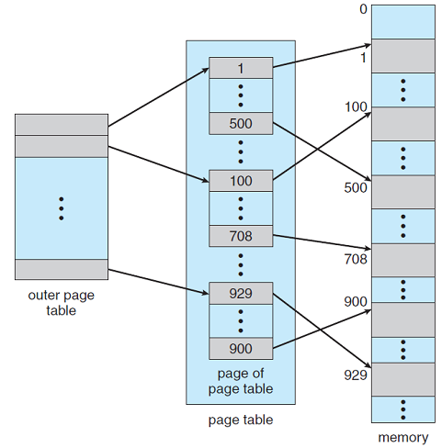
A) Hierarchical paging
Use of two-level page table!
We then page the page table!

Slide 52

Two-level paging - example
A logical address, on 32-bit machine with 1 kB page size, is divided:
A page offset consisting 10 bits
A page number consisting of 22 bits
Since the page table is paged, the page number is divided into:
A 12-bit page number
A 10 bit page offset
Thus a logical address is:
where p₁ is an index into outer page table, and p₂ is the displacement within the page of inner page table
Known as forward-mapped page table

Slide 53
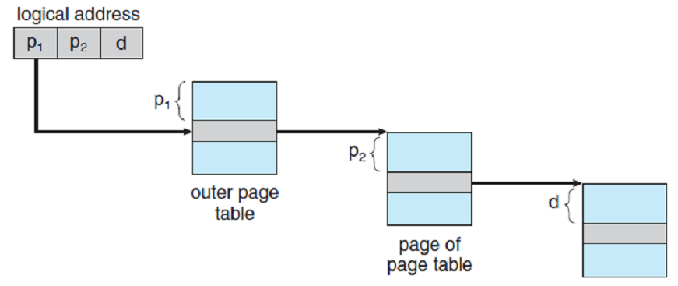
Address-translation scheme

Slide 54

64-bit logical address space
Even two-level paging scheme is not sufficient
If page size of 4 kB (2¹²)
Page table entries = 2⁵²
Assuming each page table entry size = 4 B
If two-level scheme, inner page table could be 2¹⁰, 4 kB entries
Outer page table has 2⁴² entries or 2⁴⁴ B
Address would look like:

Slide 55
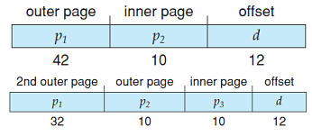
Three-level paging scheme
One solution is to add a 2nd outer page table
But in the following example, the 2nd outer page table is still 2³⁴ bytes in size!
And possible 4 memory access to get to one physical memory location:

Slide 56
B) Hashed page tables
Common in address space > 32 bits
The logical page number is hashed into a page table
This page table contains a chain of elements hashing to the same location

Slide 57
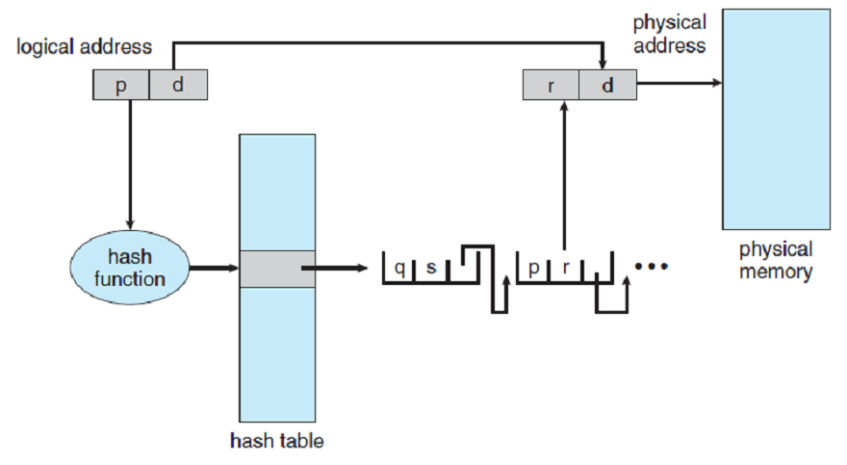
Hash page table scheme
Each element contains
Logical page number
Physical frame number
Pointer to the next node
Search is done serially in the linked list

Slide 58
C) Inverted page table
Rather than keeping all possible logical page numbers, track all physical pages (frame) numbers
One entry for each physical page of memory
Entry consists of
Virtual address of the page stored in that frame
+ Process info

Slide 59
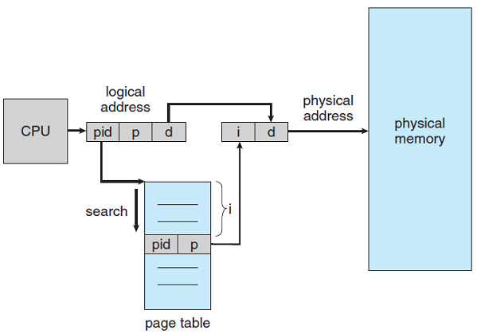
Inverted page table scheme

Slide 60
Problem and solutions
Good:
Decrease memory needed
Bad:
Increase time needed to search the table
Use hash table to limit the search to one, or at most a few, page-table entries.
How to implement shared memory?
One mapping of a virtual address to the shared physical address

Slide 61

Questions?

